Slide 1

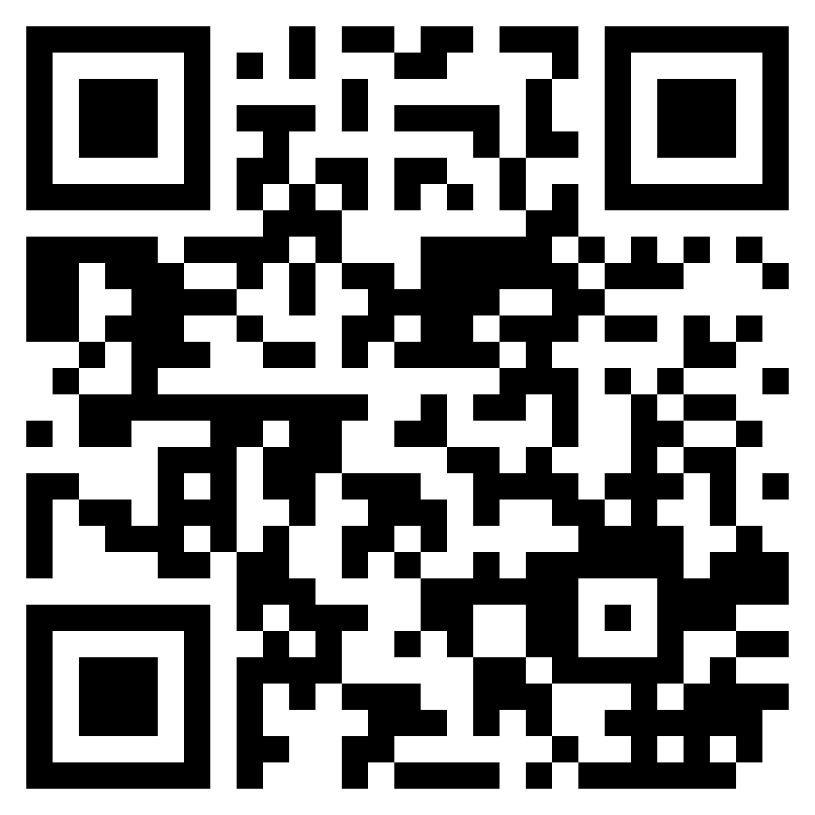

Slide 2
WATERWISE
Group A
Joshua Godinho
Mithali Jagadeesh
Muskan
Phaneendra
Rebecca
Rima Modak

Slide 3

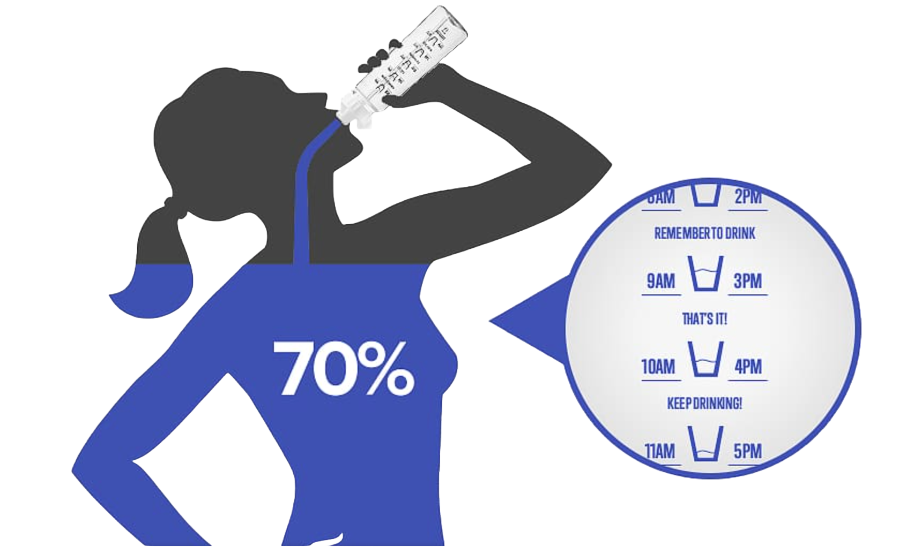
Dehydration can impair cognitive function!
Studies show that if your hydration levels are even 3% off of where they should be, you can experience noticeable impairment. Short term memory, visual perception, and motor ability all became significantly impaired in those who were dehydrated.
75% of Americans are chronically dehydrated!
According to an article by the National Institute of Health (NIH), the lay press estimates 75% of Americans are chronically dehydrated.
Men need to drink around 104 oz of water / day
Women need to drink around 72 oz of water / day

Slide 4

EXPLAIN SOLUTION

Slide 5
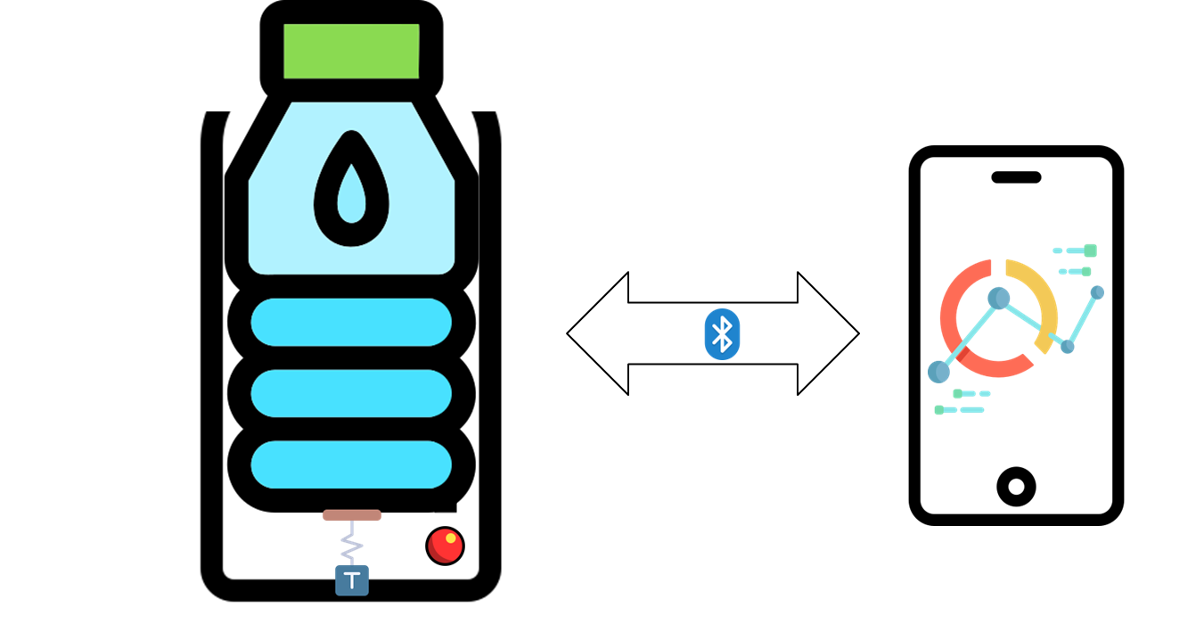
PROPOSAL PLAN

Slide 6
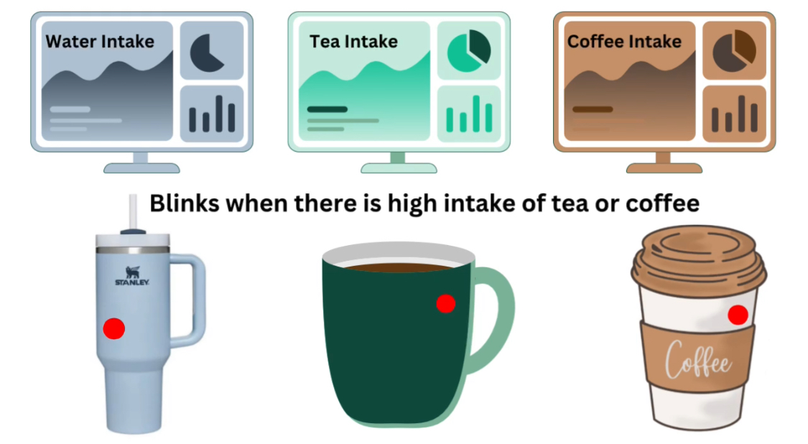
OPPORTUNITIES
Non tech savvy audience
Step towards sustainability
Promote awareness towards health
Personalized usage
Building habits from young age

Slide 7

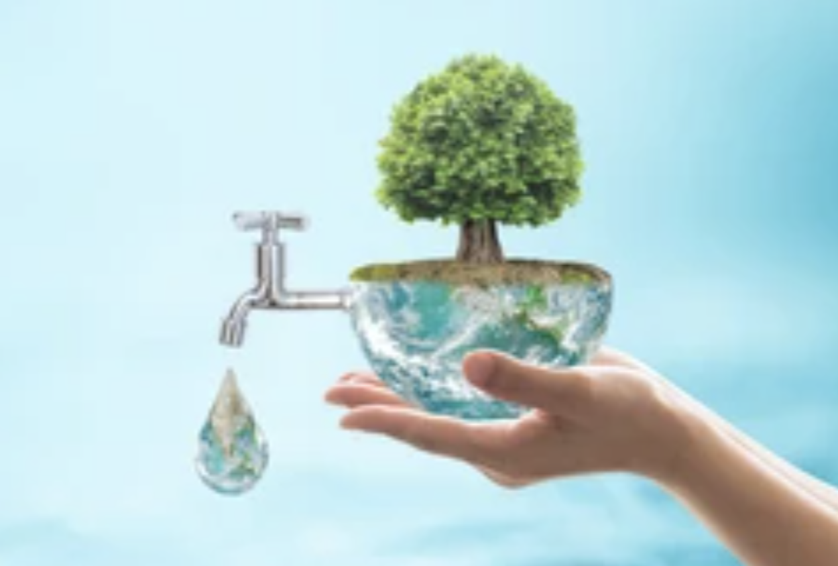
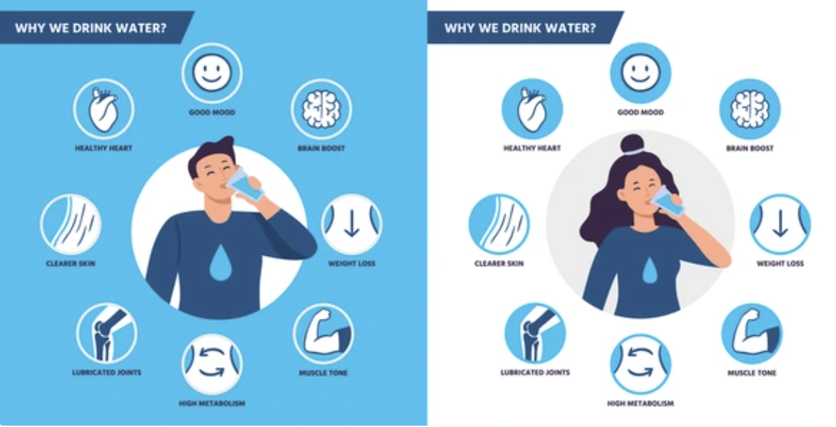
BENEFITS OF THE PROJECT
Improved Hydration:
Tracks and monitors water intake throughout the day.
Reminds users to drink water, promoting consistent hydration.
Clinically proven to lead to increased water consumption and improved focus
Sustainability:
Reduces plastic waste by replacing disposable water bottles.
Contributes to ESG practice(Environmental Social Governance) by reducing plastic pollution in oceans and landfills
Overall Health:
Enhances physical health by reducing fatigue, improving digestion, and promoting healthy skin.
Supports mental well-being by reducing the risk of dehydration-related cognitive impairments

Slide 8
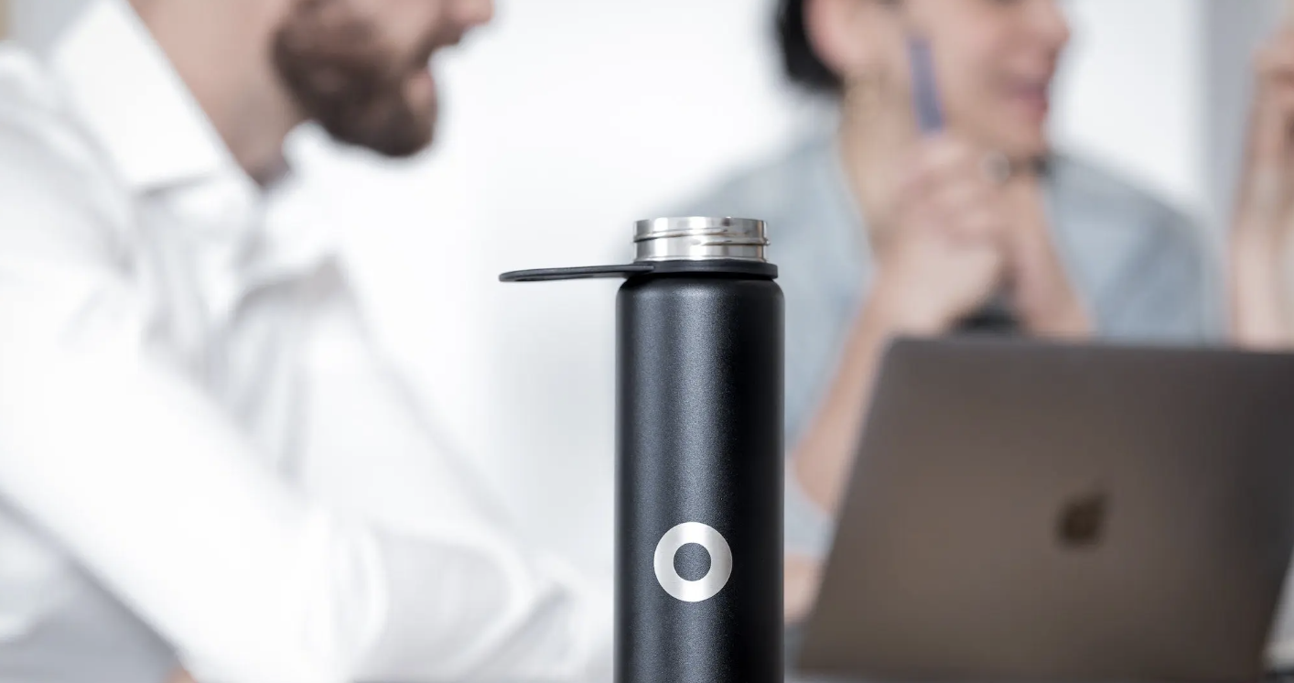
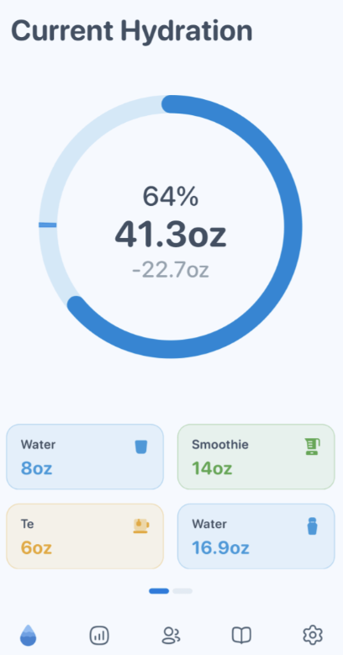
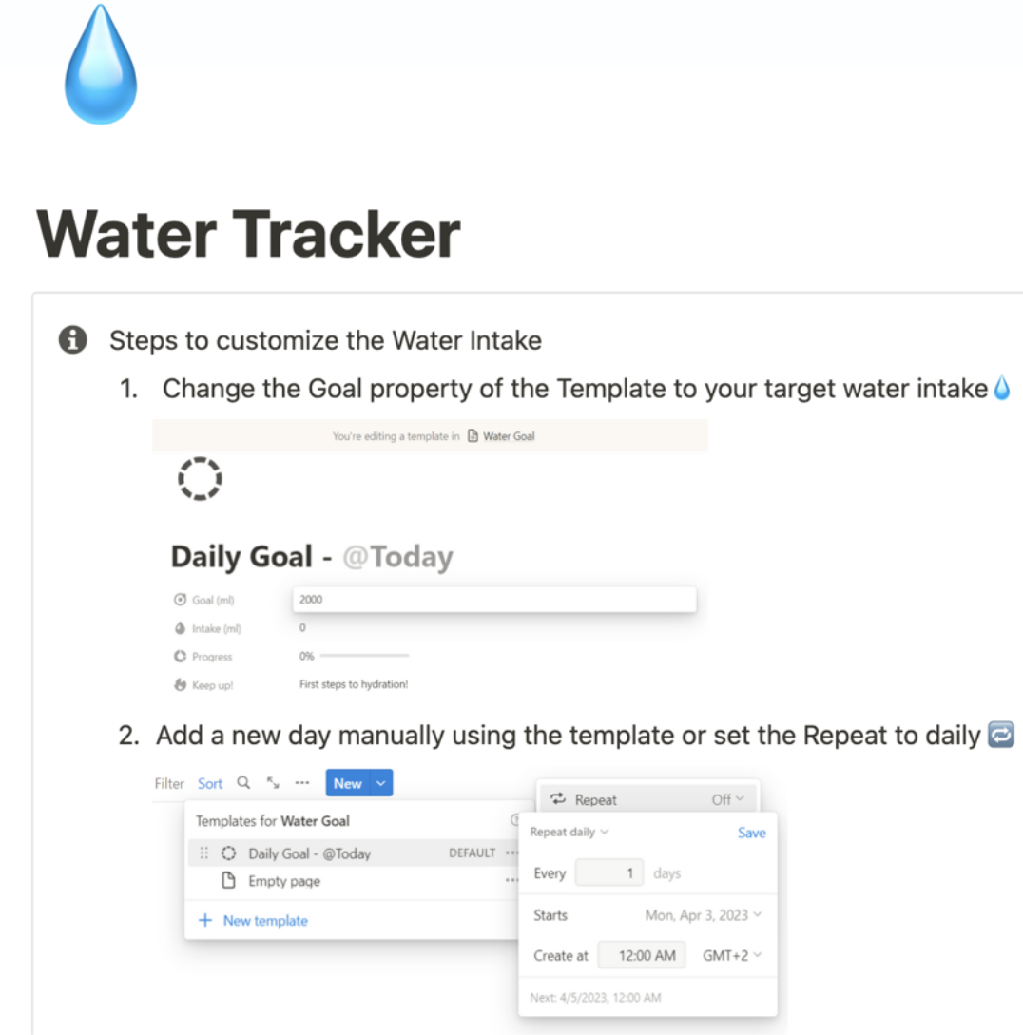
BENEFITS OF THE PROJECT
Increased Productivity:
Seamlessly integrates into daily routines to boost productivity.
Helps reduce common consequences of dehydration such as headaches, body aches, and fatigue
Integrated App:
Allows users to set personalized hydration goals and track progress.
Syncs with fitness apps to ensure hydration matches activity levels, enhancing sports and exercise performance
Customizable Settings:
Personalized reminders based on activity level and environmental conditions.
Caters to all the medical needs and customization prescribed by doctors.

Slide 9
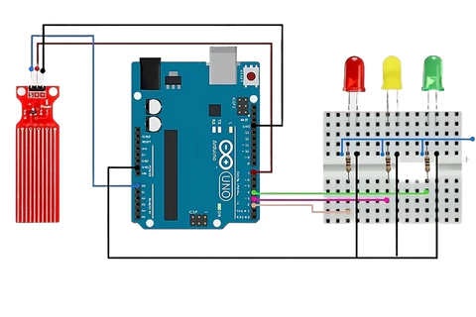
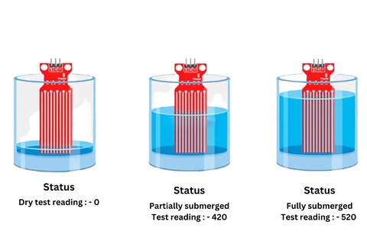
Resource Allocation
The WaterWise project combines a smart bottle with LED reminders, Apache and Django for backend support, and an ESP module for data handling. The budget covers development and an adaptive resource planning strategy ensures user-centric, technologically advanced outcomes based on feedback and testing.
The key components used in the WaterWise project:
Physical Smart Bottle with LED Reminders: The smart bottle is a key hardware component, equipped with LED reminders to prompt users to stay hydrated.
Web and Server Technology: The project utilizes web and server technologies for backend support. Platforms like Apache and Django are employed to ensure robust and efficient server-side operations.
ESP Module: The ESP module is used for hardware communication, enabling the smart bottle to interact with the server and transmit data.
Database Schema: An efficient database schema is crucial for data handling, ensuring real-time tracking and user interaction with the system.
Adaptive Resource Planning: The project employs an adaptive resource planning strategy, allowing for technological iterations and enhancements based on user feedback and testing outcomes. This ensures that the final product is user-centric and technologically advanced.

Slide 10
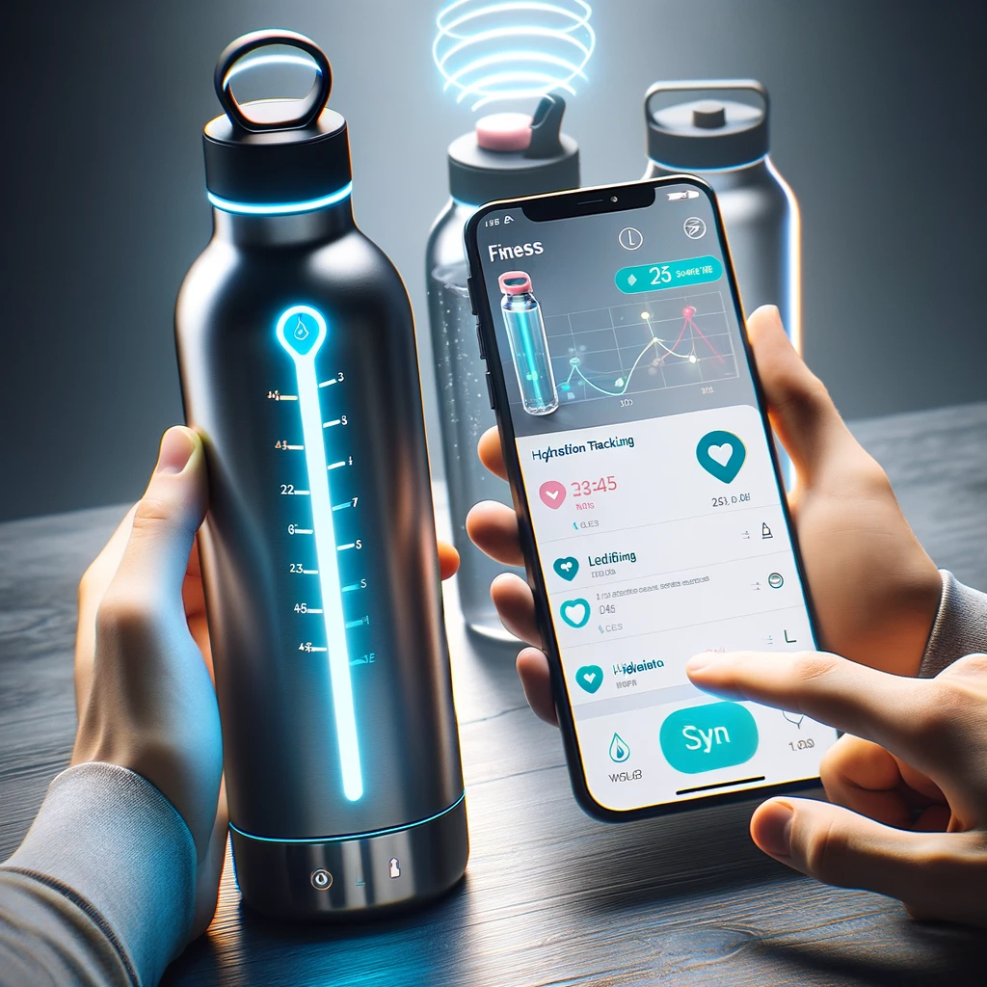
FEATURES AND FUNCTIONALITIES
Hydration Reminder: Uses a glowing LED to prompt users to drink water periodically, turns off only when at least 50 ml is consumed.
Real-time Tracking: Provides instant data on water intake, helping users monitor and track hydration levels.
User-Friendly: Designed for ease of use and customization to fit individual preferences.
Technical Components: PCB with bluetooth module, 3kg load cell and LED notifier, rechargeable battery.
Web Integration: Database, Web Server, Mobile application

Slide 11
BUSINESS CASE
Executive Summary and Project Definition
We propose a healthcare project i.e. a smart water bottle with a weight detection tool that helps us identify the consumption of water through weight deficit. This bottle in collaboration with a web application tracks the consumption of water for a person and sets reminders to consume water whenever the consumer is deficient.
Origin:
We recognise the pivotal role that hydration plays in a consumer’s wellbeing and the dissatisfaction of existing manual tracking systems. To address this gap our team has developed a Smart hydration system around a technologically advanced water bottle and a seamlessly integration web application
Motivation:
The motivation behind this project lies in our commitment to preventive healthcare and foster a culture of well being, envisioning a positive societal impact which drove us not only to create a solution to measure water consumption but also actively encourages users to consume water.

Slide 12
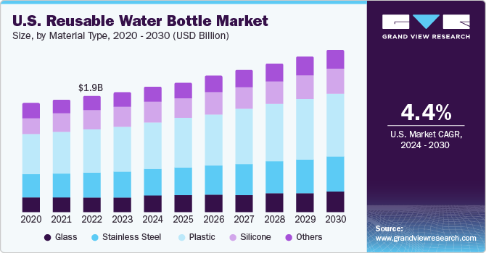
Market Research
The global reusable water bottle market was valued at USD 9.28 billion in 2023 and is expected to grow at a compound annual growth rate (CAGR) of 4.4% from 2024 to 2030.

Slide 13
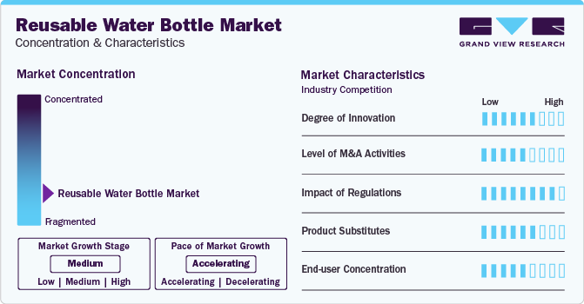
Why is this happening?
The plastic material type segment dominated the market with a revenue share of over 36% in 2023. This is attributed to the low cost of manufacturing by producers. The greater life expectancy of plastic reusable water bottles has increased consumers’ interest in the consumption of reusable water bottles.
A majority of the new companies in the market are focusing on establishing a portfolio of stainless-steel bottles as they are naturally BPA-free and an excellent alternative to single-use plastics
The global Smart Water Bottle Market size was worth around USD 36.94 million in 2022 and is predicted to grow around USD 145.20 million by 2030 with a compound annual growth rate (CAGR) of roughly 18.71% between 2023 and 2030.

Slide 14
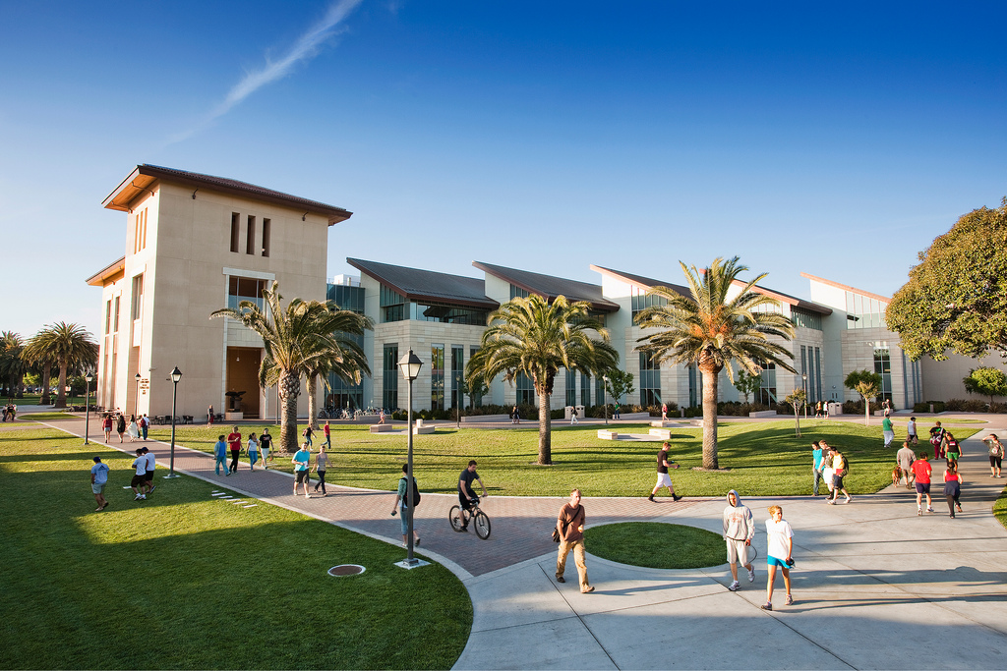
Strong relationships with 3rd parties
Collaborating with schools, colleges, or universities especially Santa Clara University to promote the WaterWise system among students and faculty as part of a holistic health and well-being initiative.

Slide 15
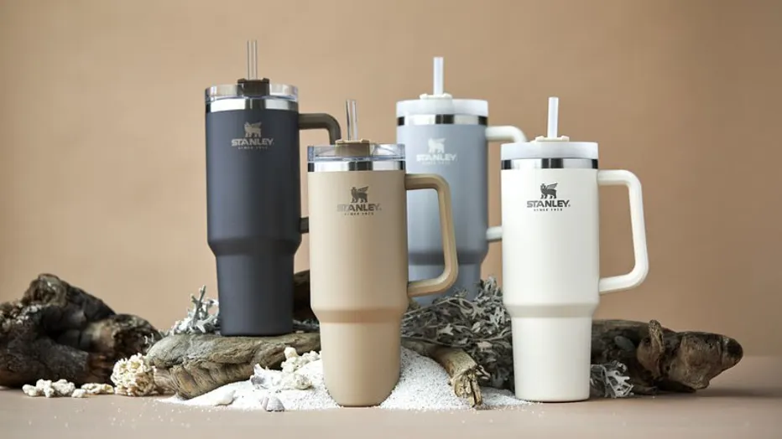
Alliance with Stanley cups
The survey found that residents of 19 states (38%) searched for Stanley Tumblers more than other brands, followed by Brita and Yeti closing in on third.
Stanley has benefited from garnering the attention of influencers on Instagram and TikTok, many of whom are Gen Z and Millennial moms, who praise the tumblers for their durability and many color options.
According to Stackline, its mugs and tumblers category saw a 926% increase in sales in 2022 and 2023 alone with currently at 275 % increase in sales because of the car accident incident.

Slide 16
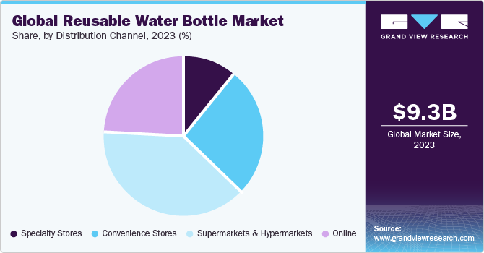
Partnering with online retailers, such as Amazon or Walmart, to expand the distribution channels for the WaterWise smart water bottle.
The online distribution channel of the reusable water bottle market is estimated to expand with a CAGR of 5.1% over the forecast period of 2023 - 2030.

Slide 17
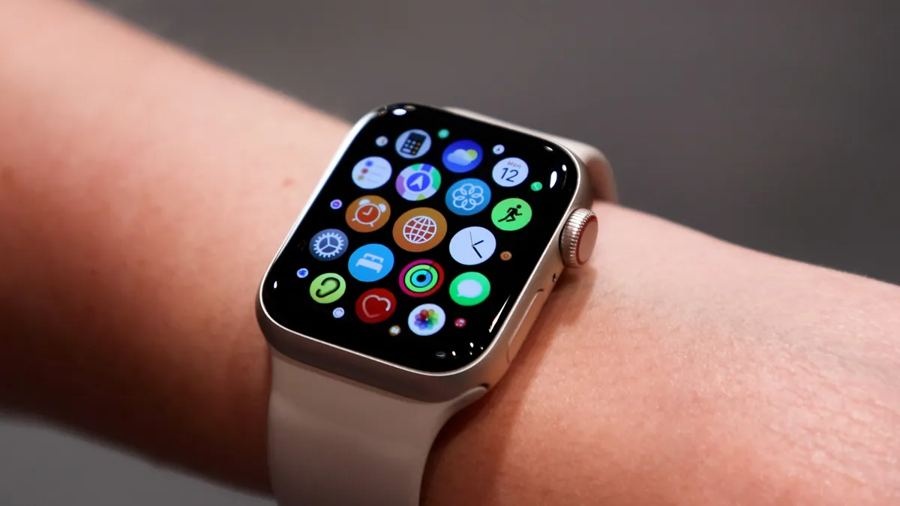
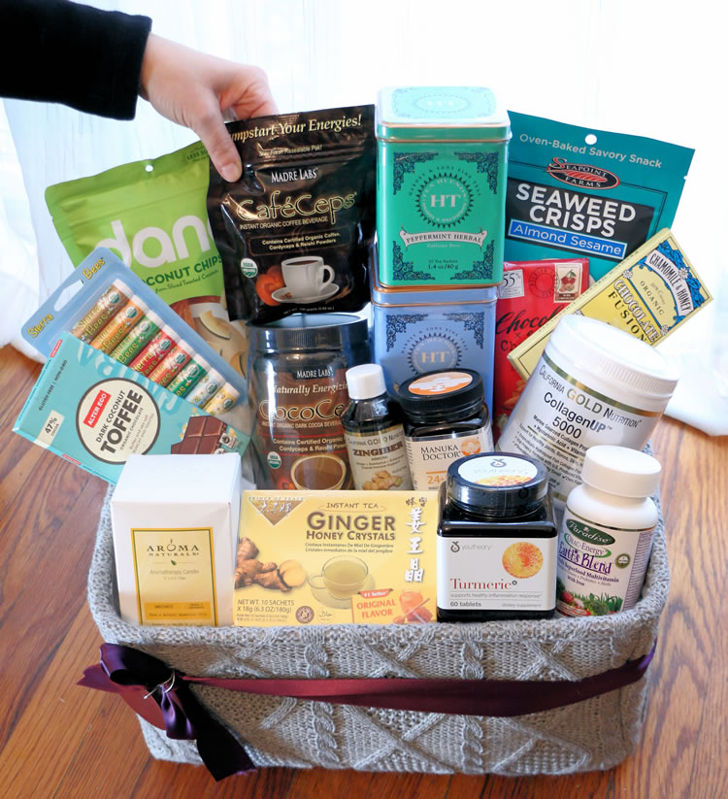
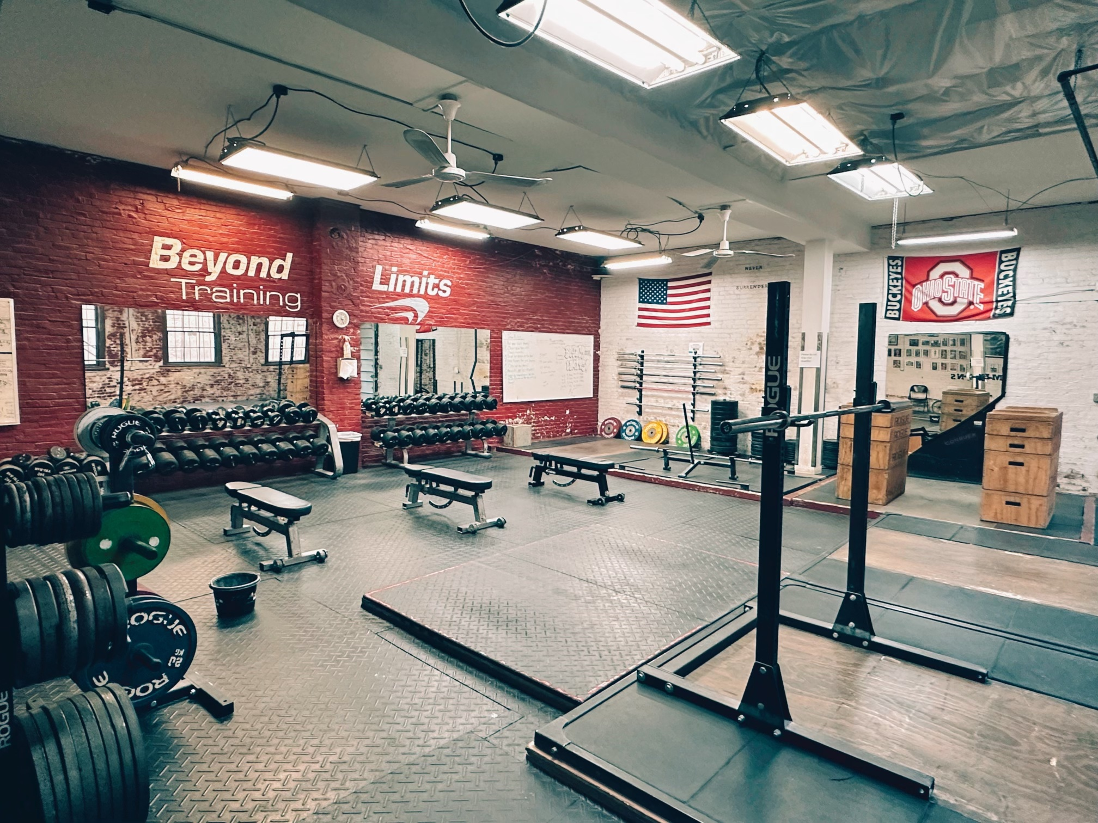
Companies like Fitbit or Strava can integrate the WaterWise data into their platforms, offering users a comprehensive health and wellness tracking experience.
Partnering with smartwatch or fitness tracker manufacturers, such as Apple, Garmin, or Samsung, to synchronize hydration data with their devices.
Partnering with water or beverage companies to cross-promote products and offer bundled deals to consumers interested in both hydration and nutrition.
Forming partnerships with fitness chains like Planet Fitness or Anytime Fitness to integrate the HydrateWell app into their member wellness programs.

Slide 18
RESOURCE REQUIREMENTS

Slide 19
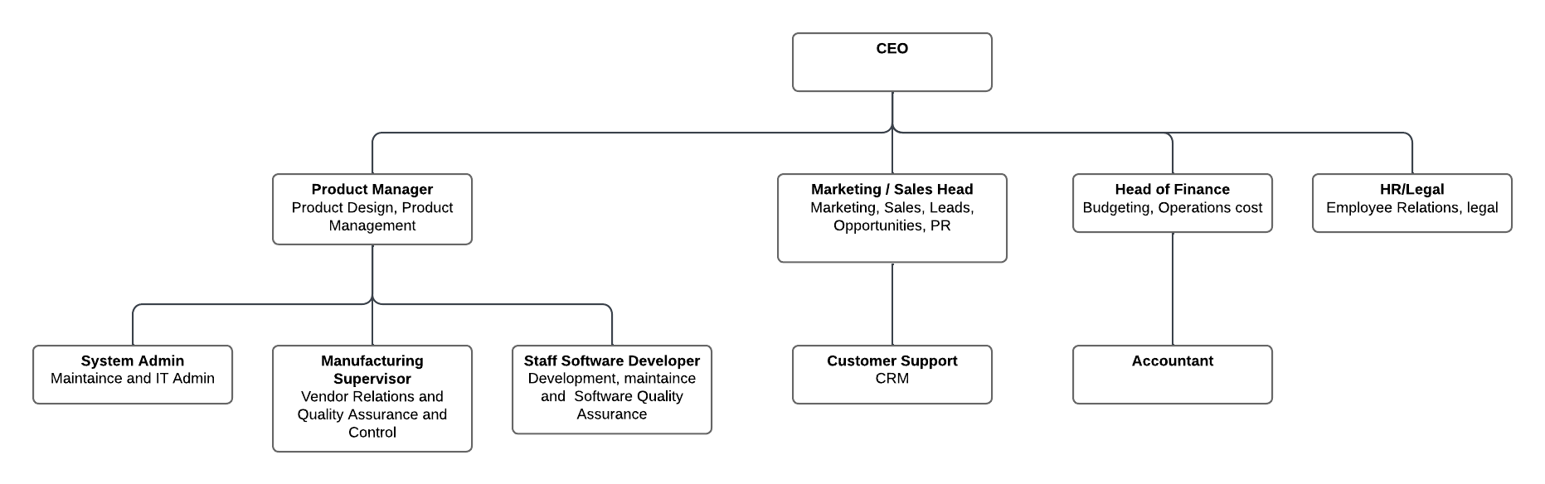
Human Resources & Roles

Slide 20
Team and Management Structure
(Following Strong Project Matrix for creating the team organization)
Project Manager (Rima) | The 1 responsible for managing the project
Project Sponsor (Classmates) | Provides financial resources for the project (aka Investors)
Senior Management (Phaneendra) | Senior to the PM in the organization
Functional Manager (Rebecca) | Owns resources working on project
Team: Muskan Joshua Mithali | Resources assigned to project and works on developing the project. Product promotion duties and staticital diversity head Marketing and campaign head Project risk and finance head
Stakeholder (Professor Kern.Peng and those mentioned above) | Anyone who will be affected by the project.

Slide 21

Roles and Responsibilities
Resource Allocation Strategy
Efficient Distribution: Our project resources are carefully distributed to prioritize key project areas—R&D, marketing, and user experience design receive full support.
Financial Oversight
Budget Allocation: Financial investments are channeled into pivotal segments like technological innovation, software development, and robust user testing.
Team Dynamics
Optimized Collaboration: Our team's configuration leverages the unique expertise of each member, from Muskan's promotional insights to Mithali's financial acumen, enhancing overall project agility.
Response to Feedback
Adaptation and Refinement: Feedback loops are integral to our process, allowing Joshua's marketing campaigns and Muskan's diversity strategies to evolve with user insights.
Organizational Support
Guidance and Execution: With Rebecca managing resources and Phaneendra providing executive direction, the team operates within a framework of strong leadership and clear objectives.
Stakeholder Engagement
Inclusive Decision-Making: Professor Kern.Peng, alongside the project sponsors and senior management, are engaged in a participative approach, ensuring decisions benefit all stakeholders.

Slide 22
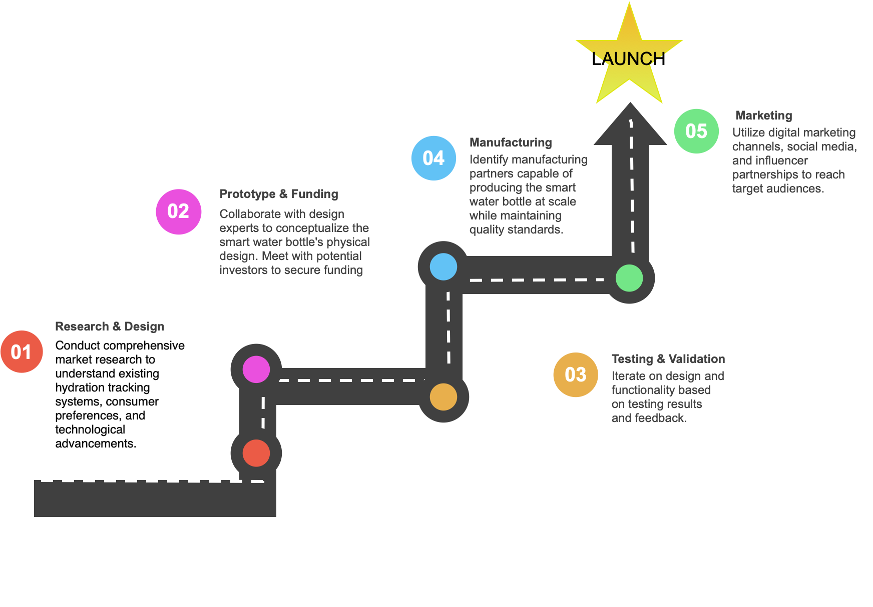
ROADMAP

Slide 23


TIMELINE

Slide 24
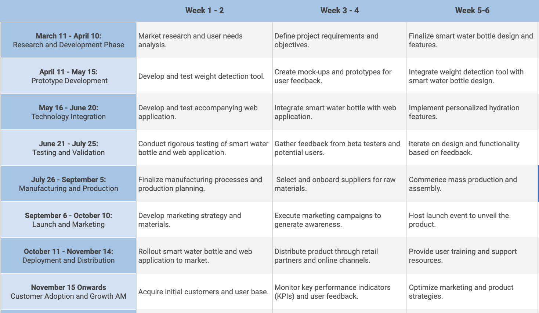

Slide 25
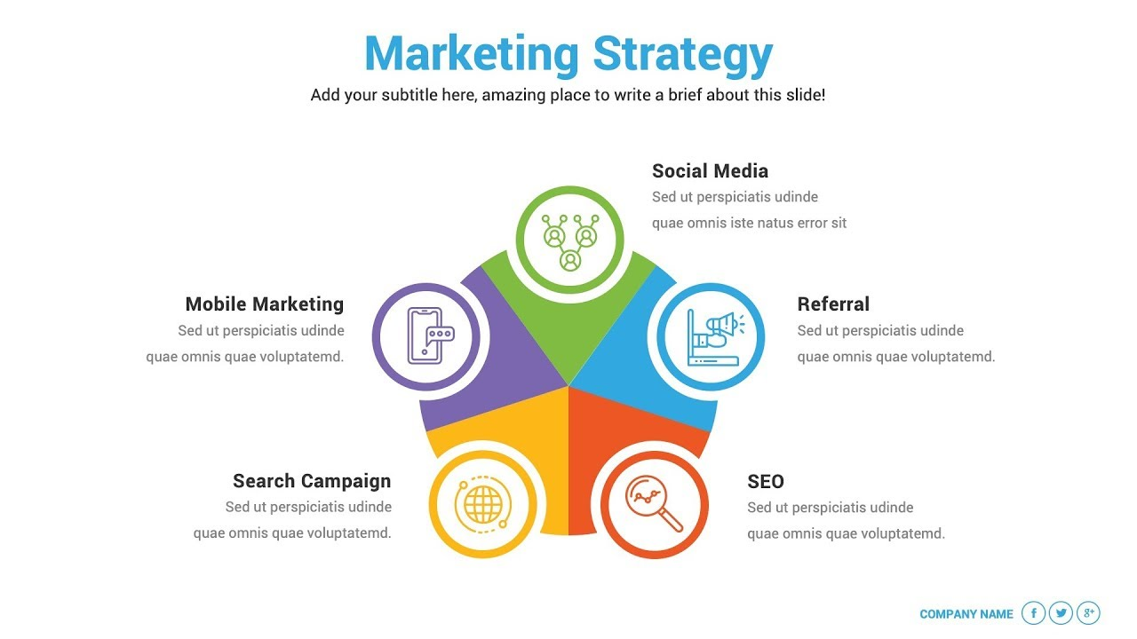
Marketing Strategy:
Connect and grow with the community
Monitor engagement and conversations to refine strategy.
Engage with your audience on-the-go
Utilize location-based services to offer contextual offers.
Encourage word-of-mouth promotion
Implement a referral program with incentives for both referrer and referee.
Capture intent through targeted keywords
Conduct keyword research to identify opportunities.
Increase organic visibility and rankings
Optimize on-page elements with relevant keywords and content.

Slide 26
BUDGET

Slide 27
COST BREAKDOWN
Manufacturing costs:
Cost of manufacturing bottle in bulk in China per bottle - $4
Cost of the PCB manufacturing in bulk in China per bottle - $6
Integration and Quality Control per bottle - $3
Shipping and logistics per bottle - $3
Other costs: facility maintenance, insurance $2
Cost to manufacture 1 bottle : $18
Software development, testing, maintenance - outsourced: $30k/year
Mobile Application Development
Integration with Hardware
Testing and Quality Assurance
Software maintenance and bug fixes

Slide 28
COST BREAKDOWN
Marketing and promotion: $50K
Market Research
Branding and Positioning
Website Development
Content Creation
Social Media Marketing
Paid Advertising
Email Marketing
Events and Sponsorships
Analytics and Measurement
Research and Development (R&D):$20k
Initial R&D costs for designing the smart features, such as sensors, connectivity, and app development.
Cost for prototyping and testing.
Innovations

Slide 29
INVESTMENT & RETURN ON INVESTMENT
Metric | Value
Initial Investment | $200K
Self funding | $50K
Investment we are seeking | $200K
Estimated Annual Sales | 20K
Estimated Annual Revenue | $800K
Selling Price per Bottle | $40
Revenue for 20K Sales | $800K
Estimated Annual Expenses | $260K
Cost per Bottle | $18
Cost of Manufacturing Bottles | $160K
Annual Net Profit | $440K
ROI | 220%

Slide 30
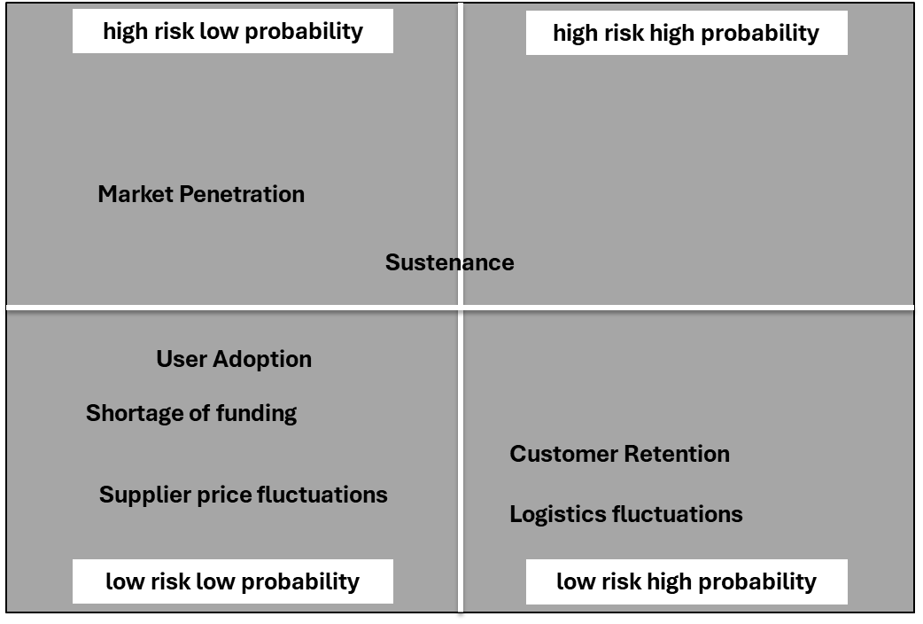




Risk Analysis
External Risks
Market Penetration and Sustenance
Internal Risks
Shortage of funding
Supplier price fluctuations
Customer Retention
Logistics fluctuations
Mitigation and Contingency
Aggressive Marketing
Tie ups with companies, universities and fitness centers
In house manufacturing
Innovate business model
The Project Risk Profile

Slide 31
CONCLUSION
Cost of operations over 1 year:
Product go-live: 8 months
ROI: 220%
In conclusion, the WaterWise project stands as a beacon of innovation and sustainability, promising a future where water is not just a resource, but a wellspring of life and prosperity. Together, let's turn the tide towards a water-wise world.

Slide 32
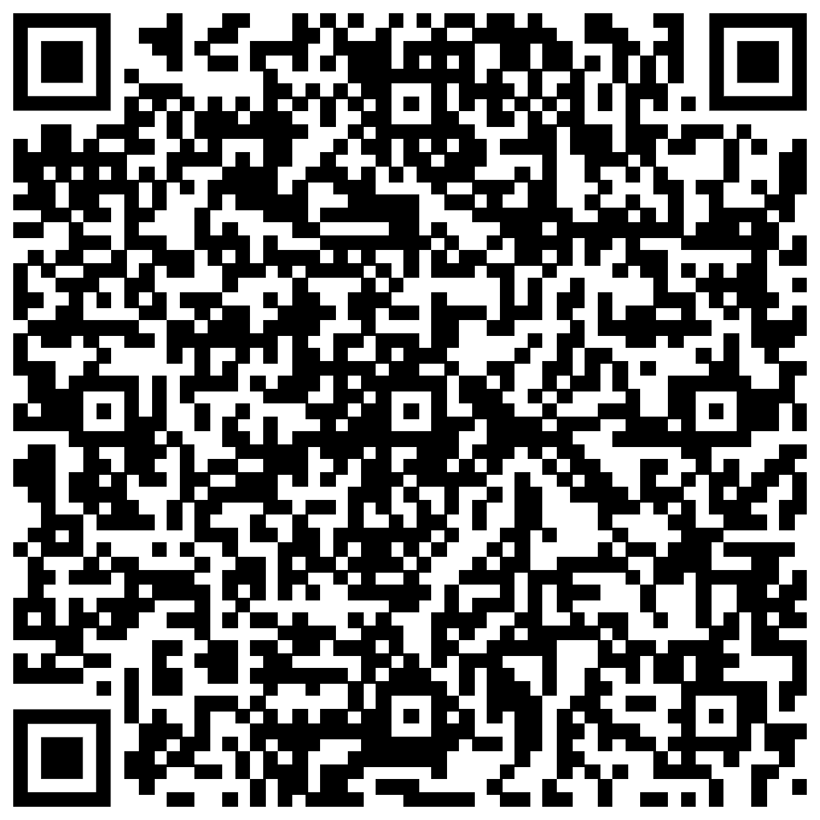
Kahoot Quiz !
Scan and play to Win Prizes

Slide 33
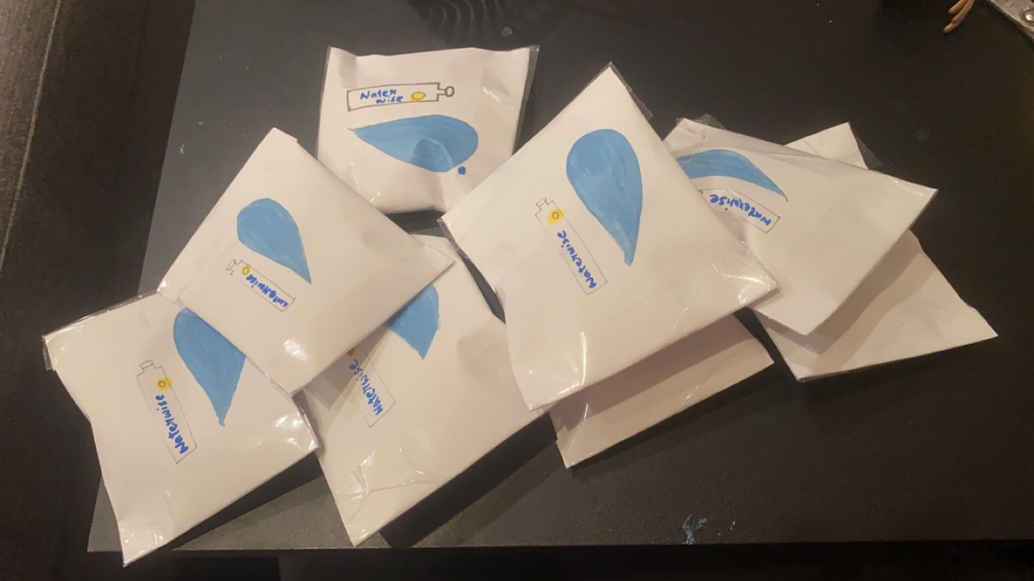
Giveaway!

